Slide 1
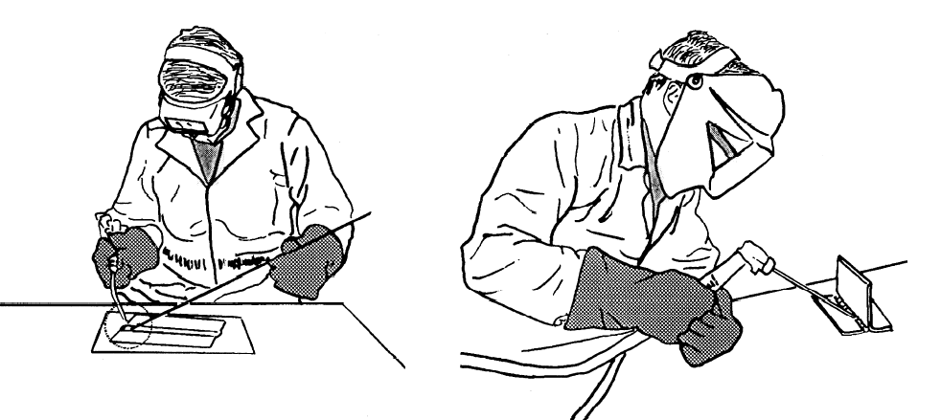
WELDING

Slide 2
WELDING
Welding is a materials joining process which produces joint of materials by heating them to suitable temperatures with or without the application of pressure and with or without the use of filler material.
Welding is used for making permanent joints.
It is used in the manufacture of automobile bodies, aircraft frames, railway wagons, machine frames, structural works, tanks, furniture, boilers, general repair work and ship building.

Slide 3
TYPES
Plastic Welding or Pressure Welding
The piece of metal to be joined are heated to a plastic state and forced together by external pressure
(Ex) Resistance welding
Fusion Welding or Non-Pressure Welding
The material at the joint is heated to a molten state and allowed to solidify
(Ex) Gas welding, Arc welding

Slide 4
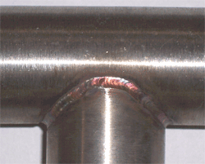
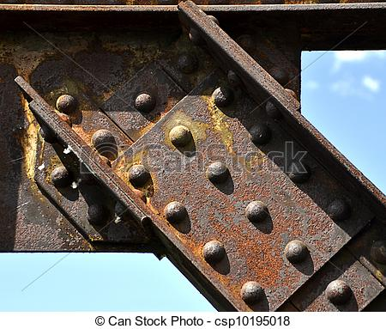
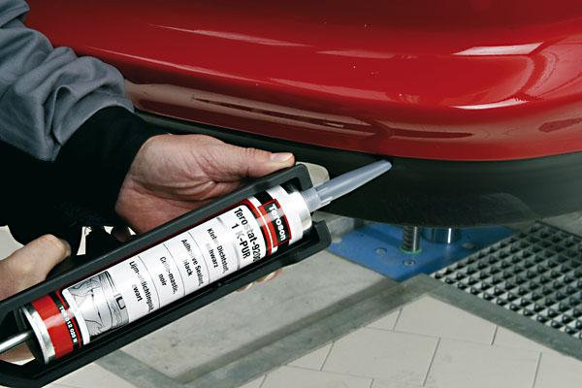
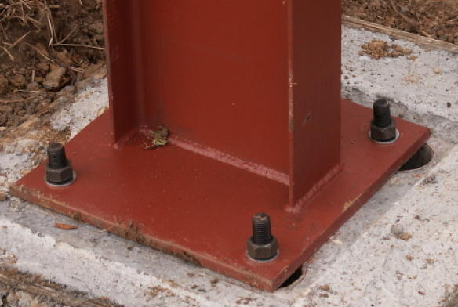

Slide 5
Classification of welding processes:
(i). Arc welding
Carbon arc
Metal arc
Metal inert gas
Tungsten inert gas
Plasma arc
Submerged arc
Electro-slag
Atomic Hydrogen
(ii). Gas Welding
Oxy-acetylene
Air-acetylene
Oxy-hydrogen
(iii). Resistance Welding
Butt
Spot
Seam
Projection
Percussion
(iv)Thermit Welding
(v)Solid State Welding
Friction
Ultrasonic
Diffusion
Explosive
Forge
(vi)Newer Welding
Electron-beam
Laser
(vii)Related Process
Oxy-acetylene cutting
Arc cutting
Hard facing
Brazing
Soldering

Slide 6
Terminologies associated with welding process
Base metal – Work pieces to be joined
Weld bead – Material deposited by the process of welding
Puddle – Portion of the base material which is melted by the heat of welding.
Weld pass – Movement of welding torch from one end of the joint to the other.
Tack weld – Temporary weld done at the ends of the work pieces.

Slide 7
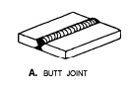
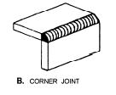
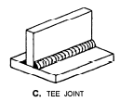
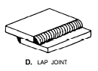
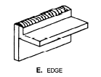
Types of Weld joints

Slide 8
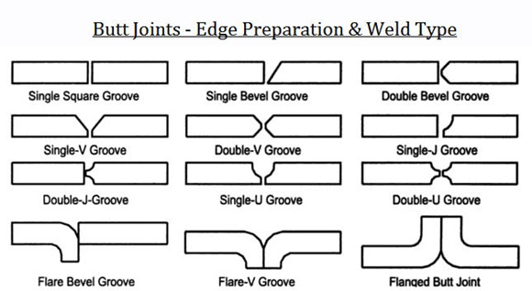
EDGE PREPARATION IN WELDING

Slide 9
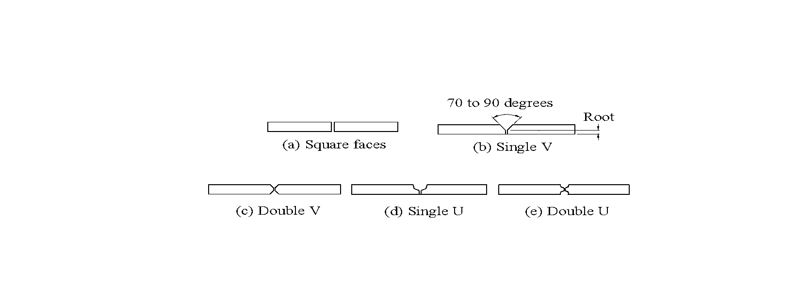
EDGE PREPARATION IN WELDING
To ensure complete penetration and sound weld , edge preparation is essential.
TYPE OF EDGES

Slide 10
GAS WELDING
Gas welding is called an oxy-fuel gas welding as heat is derives from combustion of acetylene with oxygen.
Fuel is generally used is acetylene because of high temperature generated during the process is i.e 3100⁰c
GAS | CHEMICAL FORMULA | HEAT CONTENT | FLAME TEMPERATURE
Acetylene | C2H2 | 55 | 3100⁰c
Propylene | C3H | 88 | 2500⁰c
Propane | C3H8 | 93 | 2450⁰c
Hydrogen | H2 | 10 | 2390⁰c

Slide 11
GAS WELDING PRINCIPLE
When acetylene is mixed with oxygen in correct proportion in the welding torch and ignited, the flame is produced which is sufficiently hot to melt and join the parent metal. A filler rod is generally added to build up the seam for greater strength. It may be classified as:-
1. High Pressure oxy-acetylene welding:- Acetylene is supplied from acetylene cylinder in compressed form
2. Low pressure oxy-acetylene welding:- In this acetylene gas is supplied from generator at low pressure. In the generator calcium carbide is added in the chamber in which water is already present. Acetylene starts forming and collected from top of water and used for further welding.
CaC ₂ + 2 H ₂ O → C ₂ H ₂ + Ca(OH) ₂

Slide 12
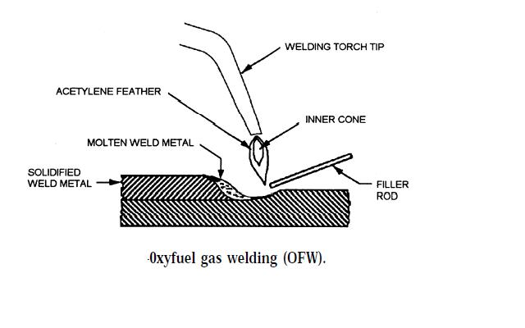

Slide 13
TYPES OF FLAMES
Neutral flame
Oxidizing flame
Carburizing flame

Slide 14
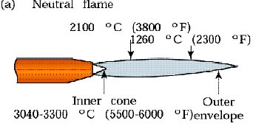
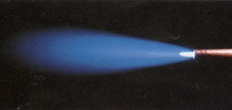
Three basic types of oxyacetylene flames used in oxyfuel-gas welding and cutting operations: (a) neutral flame; (b) oxidizing flame; (c) carburizing, or reducing flame.
Neutral flame
when oxygen to acetylene ration 1.1:1 is called Neutral flame (It has a balance of fuel gas and oxygen) (3200⁰c). Inner core light blue colour and outer core dark blue colour.
Used for welding steels, aluminium, copper and cast iron

Slide 15
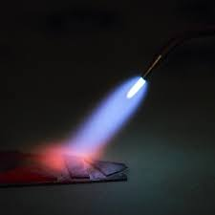
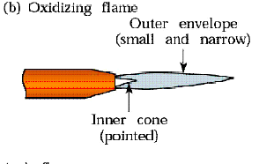
Oxidizing flame
If more oxygen is added, the inner core becomes darker and more pointed, while the envelope becomes shorter and more fierce is called Oxidizing flame. Burns with loud roar.
Has the highest temperature about 3400⁰c
Used for welding brass and brazing operation
Three basic types of oxyacetylene flames used in oxyfuel-gas welding and cutting operations:
(a) neutral flame; (b) oxidizing flame; (c) carburizing, or reducing flame.

Slide 16
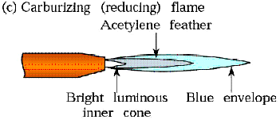
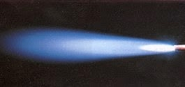
Carburizing flame or Reducing Flame
If Oxygen supplied to the neutral flame is reduced, flame immediately changes into a long white inner area (Feather) surrounded by a transparent blue envelope is called Carburizing flame (3000⁰c). Used for steel alloys like for welding high carbon steel.
Three basic types of oxyacetylene flames used in oxyfuel-gas welding and cutting operations:
(a) neutral flame; (b) oxidizing flame; (c) carburizing, or reducing flame.

Slide 17
CHEMISTRY IN GAS WELDING
Stage 1
2C2H2 + 2O2 = 4CO + 2H2
Stage 2
4CO + 2H2 + 3O2 = 4CO2 + 2H2O
Stage 3
2C2H2 + 5 O2 = 4CO2 + 2H20 (vapour) + 1284.57 k J / mol

Slide 18
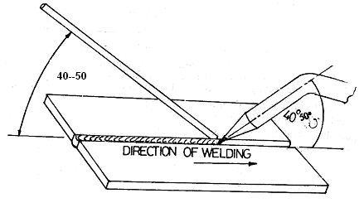
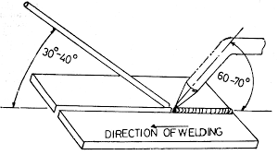
GAS WELDING TECHNIQUES
Leftward Welding Techniques
Rightward Welding Techniques

Slide 19
GAS WELDING EQUIPMENT...
1. Oxygen Gas Cylinders- coloured Black or Blue
2. Acetylene Gas Cylinders- coloured Red
Pressure
Oxygen – 125 kg/cm2
Acetylene – 16 kg/cm2
3. Regulators
4. Pressure Gauges
5. Hoses
6. Welding torch
7. Check valve
8. Non return valve
9. Gas lighter
10. Protective clothing

Slide 20
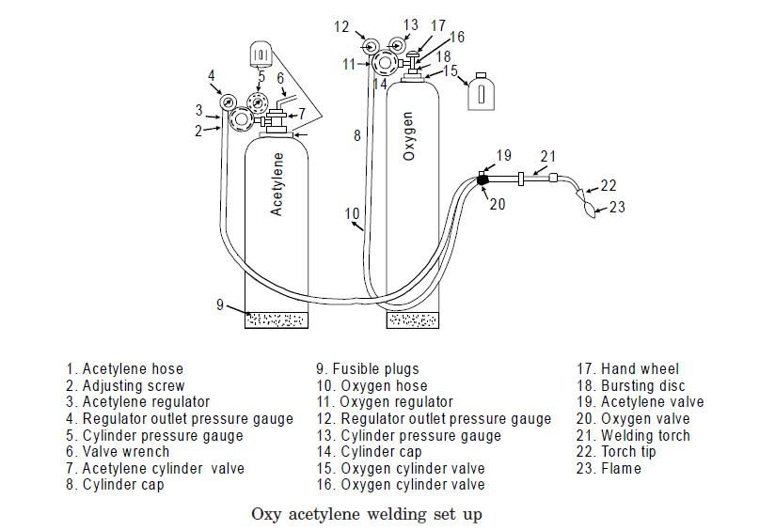
Oxy-Acetylene welding

Slide 21
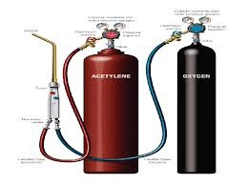
Oxy-Acetylene welding

Slide 22
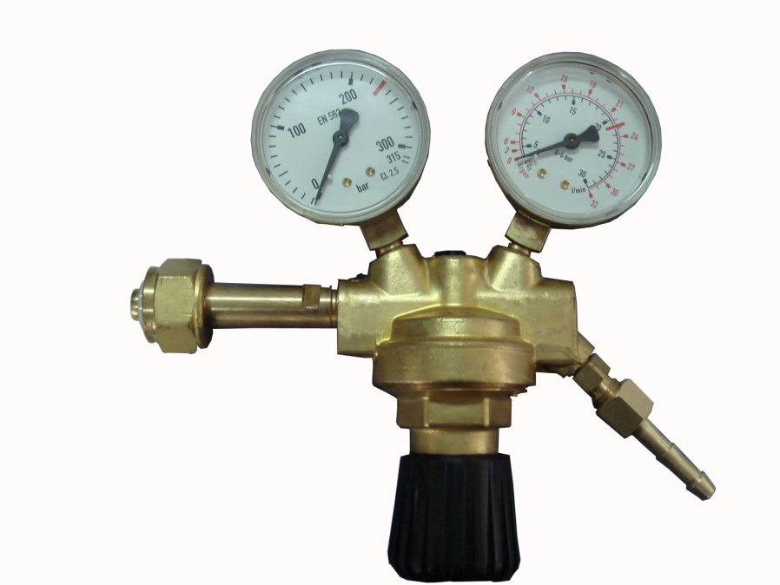
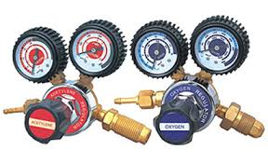
Pressure Regulator & Gauges

Slide 23
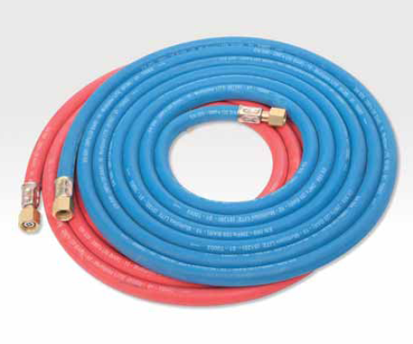
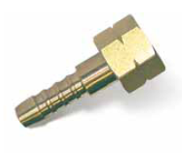
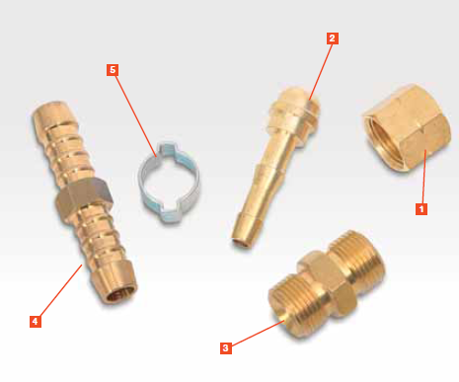
Gas Hoses
Nut coupler
Nipple
Hose coupler
Hose splicers
O clips

Slide 24
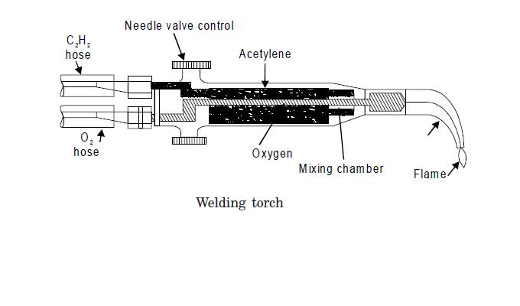
Welding Torch

Slide 25
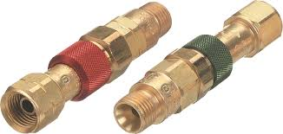
Check Valve & Non return valve
The perpose of internal check valve is to reduce the possibility of reverse flow gas.

Slide 26
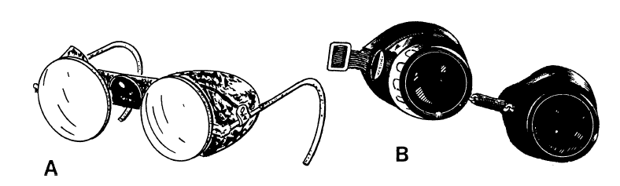
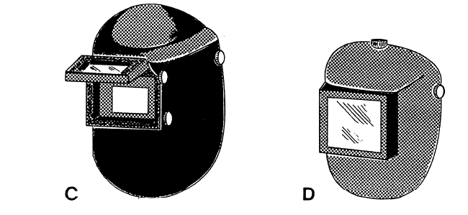
Goggles or Eye Protection

Slide 27
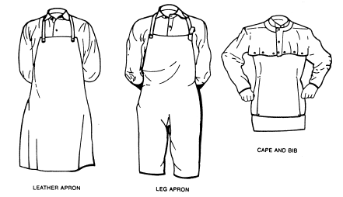
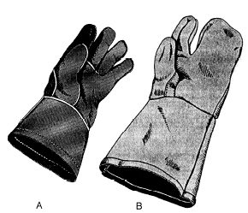
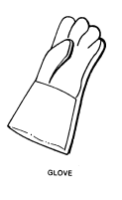
Protective Clothing & Gloves

Slide 28
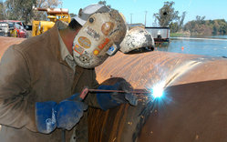
Arc welding

Slide 29
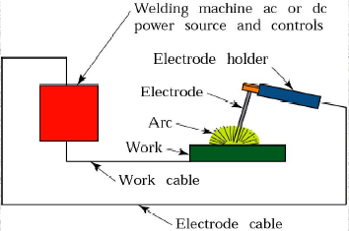
Metal Arc welding
Equipments:
A welding generator (D.C.) or Transformer (A.C.)
Two cables- one for work and one for electrode
Electrode holder
Electrode
Protective shield
Gloves
Wire brush
Chipping hammer
Goggles

Slide 30
Arc welding
Advantages
Most efficient way to join metals
Lowest-cost joining method
Joins all commercial metals
Provides design flexibility
Limitations
Manually applied, therefore high labor cost.
Need high energy causing danger
Not convenient for disassembly.
Defects are hard to detect at joints.

Slide 31
Comparison of A.C. and D.C. arc welding
Alternating Current (from Transformer)
More efficiency
Power consumption less
Cost of equipment is less
Higher voltage – hence not safe
Not suitable for welding non ferrous metals
Not preferred for welding thin sections
Any terminal can be connected to the work or electrode

Slide 32
Comparison of A.C. and D.C. arc welding
Direct Current (from Generator)
Less efficiency
Power consumption more
Cost of equipment is more
Low voltage – safer operation
suitable for both ferrous non ferrous metals
preferred for welding thin sections
Positive terminal connected to the work
Negative terminal connected to the electrode

Slide 33
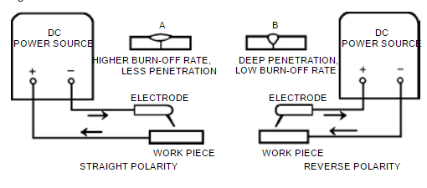
Polarities

Slide 34
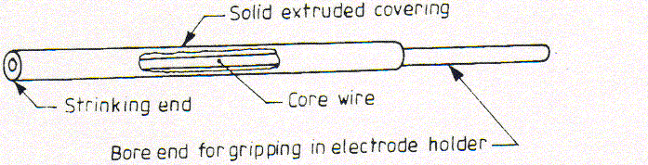
Electrodes
Filler rods are used in arc welding are called electrodes.
Metallic wires having same composition as the metal to be weld.
Coated uniformly with a protective coating called flux. e.g
titanium oxide, potassium oxide, cellulose, iron or manganese,
Ferro silicates, carbonates, gums, clays, asbestos etc…

Slide 35
Types of Electrodes
Consumable
Non-consumable- D.C(Carbon, graphite) & A.C (Tungsten). Used in carbon arc & TIG welding
Bare Electrode- Not coated with flux. Used in carbon arc & TIG welding
Coated Electrodes(Stick Electrode)- coated with flux

Slide 36
Types of Fluxes
Gas forming- Isolating welding zone from ambient air. e.g organic matter like wood pulp
Slag forming- china clay, felspar, manganese, & titanium ores
Reducing- ferro silicon,ferro titanium,ferro manganese reduces oxides
Stabilizing- Ionized the zone b/w electrode and part to be weld and ensuring stable burning.
Binding- so that covering should have proper binding with bare electrode.

Slide 37
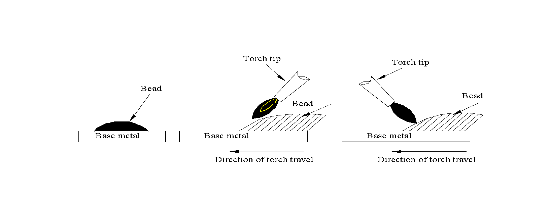
FOREHAND WELDING & BACKHAND WELDING
A weld bead | Forehand welding | Backhand welding
| less heat is flowing in the metal | heat is concentrated into the metal
| used for relatively thin parts | thicker parts are welded

Slide 38
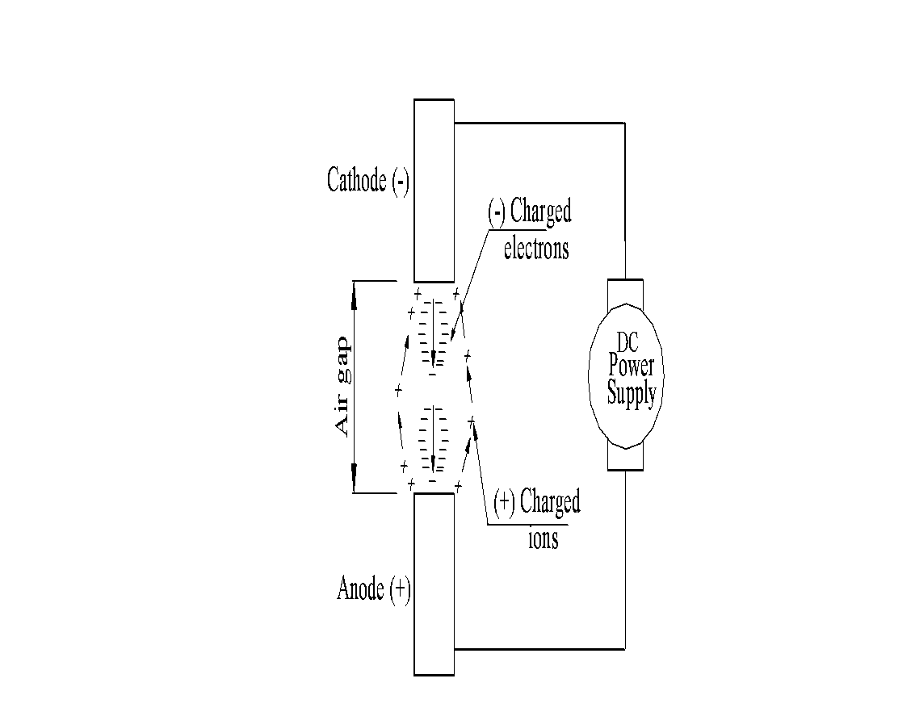
Principle of Arc welding
Arc is struck
Electrons travel form cathode to
Anode at very high speed
K.E of electrons converted to Heat
Positively charged ions from
anode to Cathode provide protecting shied

Slide 39
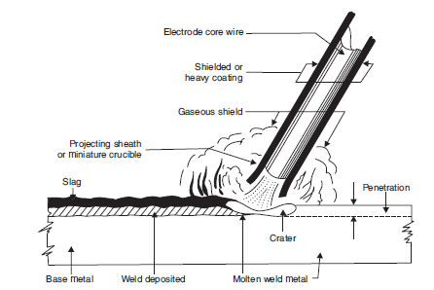
ARC WELDING PROCESS

Slide 40
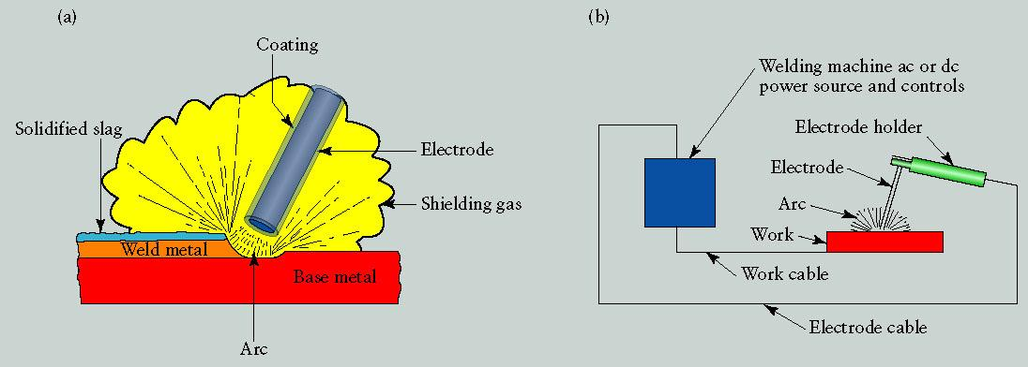
Shielded Metal Arc Welding (SMAW): “Stick welding”
Arc temperature is nearly 5500°C
The electrode is also the filler rod
Only for steel
Strong welds if done properly (but often not)
Very high heat input: good for thick parts, bad for grain growth and distortion
Kalpakjian

Slide 41
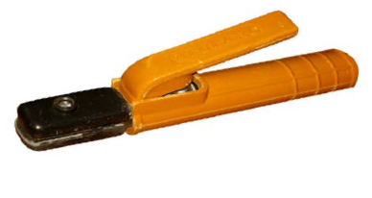
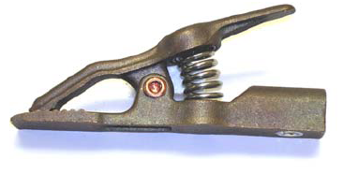
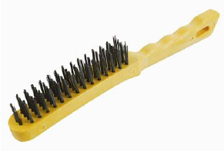
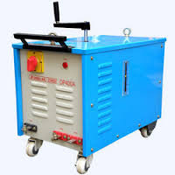
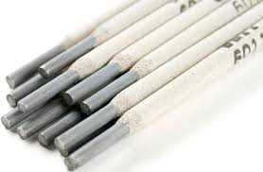
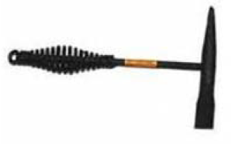
Welding Tool Equipments

Slide 42
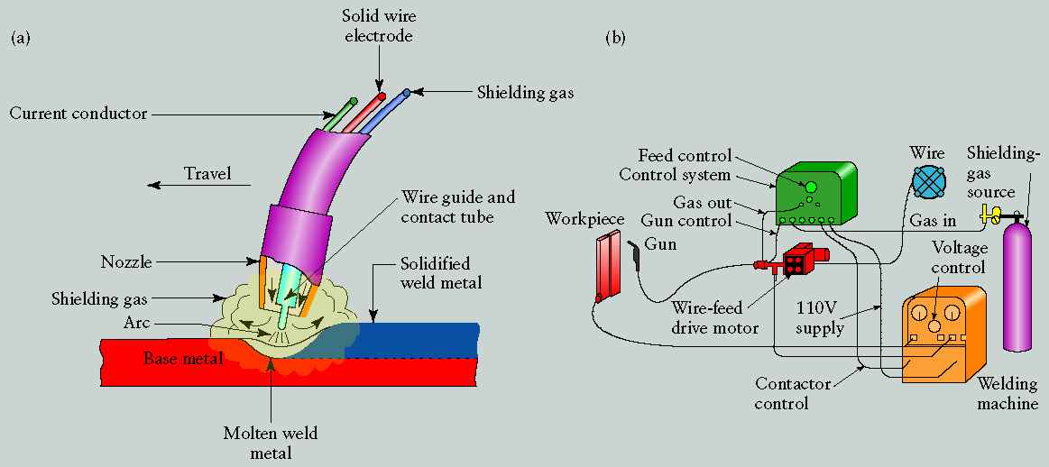
Gas Metal Arc Welding (GMAW): “MIG” (Metal-Inert-Gas)
Complex mechanism but simple to perform and easy to automate
The electrode is also the filler rod, fed continuously from a spool. It melts in the arc.
For steel or aluminum
Low skill level can achieve good weld
Medium heat input: distortion and grain growth are significant
Kalpakjian

Slide 43

Gas Metal Arc Welding (GMAW): “MIG” (Metal-Inert-Gas)
Kalpakjian

Slide 44



Gas Metal Arc Welding (GMAW): “MIG” (Metal-Inert-Gas)
A fair/typical quality MIG weld (still hot!)
www.scenta.co.uk
www.mig-welding.co.uk
www.difflock.com

Slide 45
Gas Metal Arc Welding (GMAW): “MIG” (Metal-Inert-Gas)
Advantages of Metal Inert Gas Welding (MIG, GMAW):
Continuous weld may be produced (no interruptions);
High level of operators skill is not required;
Slag removal is not required (no slag);
Disadvantages of Metal Inert Gas Welding (MIG, GMAW):
Expensive and non-portable equipment is required;
Outdoor application are limited because of effect of wind,
dispersing the shielding gas.

Slide 46

Gas Tungsten Arc Welding (GTAW): “TIG” (Tungsten-Inert-Gas)
The electrode is tungsten (not consumed)
The filler rod is separate and fed manually
High skill level required to achieve good weld
Difficult to automate
Low heat input and small weld bead: distortion and grain growth are minimized
Kalpakjian

Slide 47

Gas Tungsten Arc Welding (GTAW): “TIG” (Tungsten-Inert-Gas)
Kalpakjian

Slide 48


Gas Tungsten Arc Welding (GTAW): “TIG” (Tungsten-Inert-Gas)
Typical good quality TIG welds
DCSP-mild steel, stainless steel
Copper & Titanium
DCRP- Aluminium & Oxidised
aluminium casting
www.steelmancycles.com
www.kosman.net

Slide 49
Gas Tungsten Arc Welding (GTAW): “TIG” (Tungsten-Inert-Gas)
ADVANTAGES:-
Weld composition is close to that of the parent metal;
High quality weld structure
Slag removal is not required (no slag);
Thermal distortions of work pieces are minimal due to
concentration of heat in small zone.
DIS-ADVANTAGES:-
Low welding rate;
Relatively expensive;
Requres high level of operators skill.

Slide 50

CARBON ARC WELDING (CAW)
A process in which heat is generated by an electric arc struck between an carbon electrode and the work piece. The arc heats and melts the work pieces edges, forming a joint. Carbon arc welding is the oldest welding process. If required, filler rod may be used in Carbon Arc Welding. End of the rod is held in the arc zone. The molten rod material is supplied to the weld pool. Shields (neutral gas, flux) may be used for weld pool protection depending on type of welded metal.

Slide 51
CARBON ARC WELDING (CAW)
ADVANTAGES:-
Low cost of equipment and welding operation;
High level of operator skill is not required;
The process is easily automated;
Low distortion of work piece.
DIS-ADVANTAGES:-
Unstable quality of the weld (porosity);
Carbon of electrode contaminates weld material with
carbides.

Slide 52

SUBMERGED ARC WELDING (CAW)
Submerged Arc Welding is a welding process, which utilizes a bare consumable metallic electrode producing an arc between itself and the work piece within a granular shielding flux applied around the weld.
Since the electrode is submerged into the flux, the arc is invisible. The flux is partially melts and forms a slag protecting the weld pool from oxidation and other atmospheric contaminations.

Slide 53
SUBMERGED ARC WELDING (CAW)
ADVANTAGES:-
Very high welding rate;
The process is suitable for automation;
High quality weld structure
DIS-ADVANTAGES:-
Weld may contain slag inclusions;
Limited applications of the process - mostly for welding
horizontally located plates.

Slide 54


Resistance Spot Welding (RSW): “SPOT WELDING”
No filler rod: electrical current is passed through metal under pressure
Distortion and grain growth are minimized
Low skill level required
Easy to automate
Low heat input and no weld bead

Slide 55


Resistance Spot Welding (RSW): “SPOT WELDING”

Slide 56
Resistance Spot Welding (RSW): “SPOT WELDING”
ADVANTAGES:-
Low Cost
Less skilled worker required
Higher productivity
Can be easily automated
No edge preperation required
APPLICATIONS:-
Automobiles and aircraft industries
Utensils and container
Used for the welding of HSS, Low carbon steel, A, CU, NI & NI alloys

Slide 57


Resistance SEAM Welding (RSW): “SEAM WELDING”
Seam welding is similar to spot welding except that the components to be joined are gripped between revolving, circular copper rollers The
welding current is applied in a series of pulses resulting
in a corresponding series of overlapping spot welds being
made along the seam

Slide 58


Resistance SEAM Welding (RSW): “SEAM WELDING”

Slide 59

Resistance SEAM Welding (RSW): “SEAM WELDING”
ADVANTAGES:-
Produce gas or liquid tight joints.
Several parallel seams can be produced.
Overlap can be less than spot welding.
DIS-ADVANTAGES:-
Cost of equipments is high.
Welding can be done only along straight line.
Difficult to weld thickness greater than 3mm.

Slide 60

Resistance Welding (RSW): “PROJECTION WELDING”
In this process the electrodes act as locations for holding the parts to be joined and are, therefore, job-specific.
The joint is so designed that projections are preformed on one of the parts to be joined.
Projection welding enables the welding pressure and the heated weld zone to be localized at predetermined points.
This technique is largely used for small, precision components that need to be accurately located.

Slide 61
Resistance Welding (RSW): “PROJECTION WELDING”
ADVANTAGES:-
It is possible to weld more than one spot at a given time.
Life of electrode is much longer than spot welding electrode.
The uniformity and appearance of weld is better as compared to spot welding
DIS-ADVANTAGES:-
Making of projections is an extra operation.
All projection should be of same height.
Metal which cannot support projection, cannot be weld.
APPLICATIONS:-
Used for welding refrigerator condensor

Slide 62


Resistance Welding (RSW): “BUTT OR UPSET WELDING”
The two ends of the rods are brought together with just sufficient force to ensure the current can flow without arcing.
The resistance of the joint interface ensures that local heating will take place on the passage of a heavy electric current at low voltage.
When the metal in the joint zone has reached its welding temperature, the current is switched off and the axial force on the joint is increased to complete the weld.

Slide 63

Resistance Welding (RSW): “BUTT OR UPSET WELDING”
APPLICATIONS:-
In wire drawing Industries
For producing butt joint in tubes, pipes & rods etc.

Slide 64

Resistance Welding (RSW): “FLASH BUTT WELDING”
Flash butt welding is similar to upset butt welding except that the heat required for melting is obtained by means of an arc rather than the simple resistance welding.

Slide 65

Resistance Welding (RSW): “BUTT OR UPSET WELDING”
ADVANTAGES:-
It consumes less welding current
Process is cheap.
Process is fast.
It offers 100% strength factor.
Preparation of weld surface is not required.

Slide 66


“SOLDERING AND BRAZING”
Brazing and Soldering: Melting of filler rod only
Brazing: higher temperature, ~brass filler, strong
Soldering: lower temp, ~tin-lead filler, weak
Welding: Melting of filler rod and base metal
sales.nordex-online.com

Slide 67


Soldering
It is a low temperature joining process in which fusible alloy or metal is introduced in a liquid state between work piece to be joined It is performed at temperatures below 450ºC for joining. The filler metal is called SOLDER
Soldering is used for,
Sealing, as in automotive radiators or tin cans
Electrical Connections
Joining thermally sensitive components
Joining dissimilar metals

Slide 68


Types of Solder & Fluxes
Soft solder- Lead 37% and Tin 63%
Medium solder- Lead & Tin each 50%
Electrician solder- Lead 58% and Tin 42%
Plumber solder- Lead 70% and Tin 30%
Flux available in the form of powder, liquid or in paste form.
Inorganic flux(Corrosive flux)- It consist of zinc & ammonium chloride
Organic flux(Mild flux)- Lactic acid, stearic acid, benzoic acid, glutamic acid etc
Rosin(Non corrosive flux)- gum extruded from pine trees

Slide 69
Soldering Method
1. Soldering Iron Method 2. Torch Method
3. Spray Method 4. Induction Method
5. Dip & Wave Method 6. Resistance Method
7. Ultrasonic Method 8. Condensation Method
APPLICATIONS:-
Connection in radios & T.V sets etc
Radiator brass tubes for motor cars
Sometime used for repairing utensils
Wiring joint in electrical connections, battery and other terminals

Slide 70


Brazing
It is a joining process of two metal piece in which a non-ferrous alloy is introduced in a liquid state between work piece to be joined It is performed at temperatures above 450ºC for joining.
The filler metal is distributed by capillary action.
The capillary action between base metal and filler metal is higher than that between base metal and flux.
Application of flux is by spraying, brushing

Slide 71

Brazing
FILLER METAS
Aluminium silicon
Copper zinc
Magnesium
Nickel
Copper Phosphorus

Slide 72

Brazing
APPLICATIONS:-
Used for Fastening of pipes fittings, tanks, carbide tip on tools, radiators, heat exchangers etc.
It can join Cast metal to wrought metal and dissimilar metals.
Used for joining parts of cycle such as frame or rims

Slide 73
Brazing
ADVANTAGES:-
Dissimilar metals which canot be welded can be joined by brazing
Very thin metals can be joined
Metals with different thickness can be joined easily
In brazing thermal stresses are not produced in the work piece. Hence there is no distortion
Using this process, carbides tips are brazed on the steel tool holders
DISADVANTAGES:-
Brazed joints have lesser strength compared to welding
Joint preparation cost is more
Can be used for thin sheet metal sections

Slide 74



“WELDING DEFECTS”
1. Lack of Penetration
It is the failure of the filler metal to penetrate into the joint. It is due to
(a) Inadequate de-slagging
(b) Incorrect edge penetration
(c) Incorrect welding technique.
2. Lack of Fusion
Lack of fusion is the failure of the filler metal to fuse with the parent metal. It is duo to
(a) Too fast a travel
(b) Incorrect welding technique
(c) Insufficient heat

Slide 75


“WELDING DEFECTS”
3. Porosity
It is a group of small holes throughout the weld metal. It is caused by the trapping of gas
during the welding process, due to
(a) Chemicals in the metal
(b) Dampness
(c) Too rapid cooling of the weld.
4. Slag Inclusion
It is the entrapment of slag or other impurities in the weld. It is caused by
(a) Slag from previous runs not being cleaned away,
(b) Insufficient cleaning and preparation of the base metal before welding commences.

Slide 76



“WELDING DEFECTS”
5. Undercuts
These are grooves or slots along the edges of the weld caused by
(a) Too fast a travel
(b) Bad welding technique
(c) Too great a heat build-up.
6. Cracking
It is the formation of cracks either in the weld metal or in the parent metal. It is due to
(a) Unsuitable parent metals used in the weld
(b) Bad welding technique

Slide 77


“WELDING DEFECTS”
7. Poor Weld Bead Appearance
If the width of weld bead deposited is not uniform or straight, then the weld bead is termed as poor. It is due to improper arc length, improper welding technique, damaged electrode coating and poor electrode and earthing connections. It can be reduced by taking into
considerations the above factors.
8. Distortion
Distortion is due to high cooling rate, small diameter electrode, poor clamping and slow arc
travel speed

Slide 78
“WELDING DEFECTS”
9. Overlays
These consist of metal that has flowed on to the parent metal without fusing with it. The defect is due to
(a) Contamination of the surface of the parent metal
(b) Insufficient heat
10. Blowholes
These are large holes in the weld caused by
(a) Gas being trapped, due to moisture.
(b) Contamination of either the filler or parent metals.
11. Burn Through
It is the collapse of the weld pool due to
(a) Too great a heat concentration
(b) Poor edge preparation.
12. Excessive Penetration
It is where the weld metal protrudes through the root of the weld. It is caused by
(a) Incorrect edge preparation
(b) Too big a heat concentration
(c) Too slow a travel.

